Slide 1
Playa/ Beatspot/ BeatBox
Share the Beat
Project Definition
Team:
Hilla Meri, Idan Benjamin, Matan Crispel

Slide 2
Highlights
Product Name: ?
Product Short Description:
Social music network, build your own playlist station and listen to it along with your friends at the same time.
Users:
Station creators, Listeners, Admin users
Key features:
Build a playlist, listen to songs in the same time with your friends, chat, open a station and manage it.
Guest mode:
Guest can listen and chat. Can create a station and chat with “Guest” name

Slide 3
Main Pages
Home page
Browse your stations and categories
Station list
Browse all stations, filter, search by name / genres etc.
Station
Browse songs list, promote/demote songs, add songs, chat with team members
Station creator view
Login/Signup

Slide 4
Main Pages UX

Slide 5
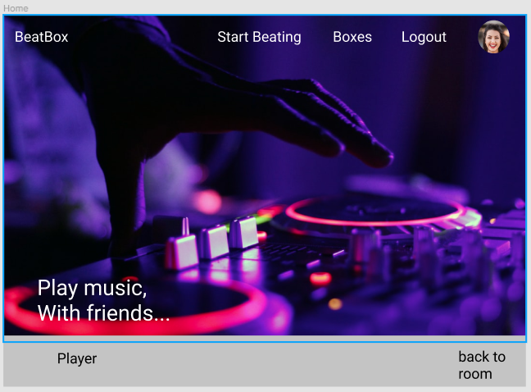
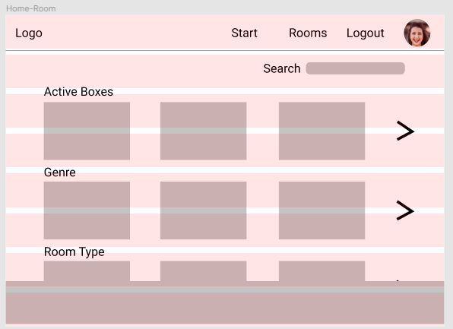
Home page
Top fold
After scroll

Slide 6
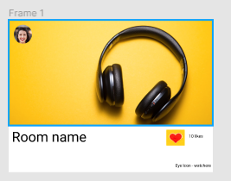
Single card
Room creator
likes
views

Slide 7
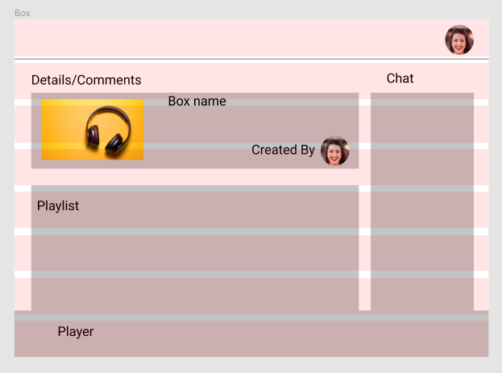
Station

Slide 8
Technical Design

Slide 9
User
{
"_id": "u101",
"fullName": “Hilla Meri",
"userName": “Hilla@gmail.com",
"password": “hilush",
"followers": [{minimal-user}, {minimal-user}],
"notifications": [
{
"txt": "Notification",
"isRead": false,
“at": 1541652422,
“data": {
{minimal-user},
action
},
{
"txt": "Notification2",
"isRead": true,
“at": 1541652422,
“data": {
{minimal-user},
action
}
],
"imgUrl": "http://some-img"
}

Slide 10
Minimal User
{
"_id": "u101",
"fullName": “Hilla Meri",
"imgUrl": "http://some-img"
}

Slide 11
Box
{
"_id": "5c09",
"name": "Funky Monks",
"tags": [
"Funk",
"Happy"
],
“description”: “some description about the box”,
"imgUrl": ”http://some-photo/”,
"createdAt": 1541652422,
"createdBy": {minimal-user},
"likedByUsers": [{minimal-user},{minimal-user}],
"songs“: [
{
"title": "The Meters - Cissy Strut",
"id": "s1001",
"youtubeId": "youtubeId",
"imgUrl": "https://i.ytimg.com/vi/4_iC0MyIykM/mqdefault.jpg",
"addedBy": {minimal-user}
},
{
"title": "The JB's - Pass The Peas",
"id": "mUkfiLjooxs",
"youtubeId": "youtubeId",
"imgUrl": "https://i.ytimg.com/vi/mUkfiLjooxs/mqdefault.jpg",
"addedBy": {}
}
]
}

Slide 12
Store - User
State:
loggedUser
Actions:
login
logout
signup
loadUser
updateUser

Slide 13
Store - Box
State:
boxes
currBox
currSong
Actions:
addBox
updateBox
removeBox
loadBoxes

Slide 14
Sockets
on:
updateUserBox – other users joined/left
playlistUpdateBox –res to update playlist changes
songStatusChange – play/pause/next/prev/seek
newChatMsg
emit:
likeBox
leaveBox
updateSongStatus
sendMsg

Slide 15
Pages
Page | Description | Routing
Home | Hero, call to action: signup or start as a guest. Below, suggested boxes from every genre. | /
BoxApp | This page contains the main list of boxes after the user chose a genre: ?genre=pop This page allows filter. | /box
BoxDetails | Shows the box info, the box playlist and chat. | /box/s101
BoxEdit | Allows creating and updating a box including all its elements | /box/edit/:id?
UserDetails | User profile including created and liked boxes | /user/u101

Slide 16
Components
Page | Description | props
BoxPreview | Preview of the box on the list. Features a “like” button and shows the participants connected count. Link to box details. | box
BoxList | List of all the boxes | boxes
BoxFilter | Filters boxes by genre or by name
BoxInfo | Info about the box in the box details page | box
ChatBox | Option to chat about the box
BoxPlaylist | Shows all the songs of the box | Songs
SongAdd | Allow the user to find a song and add it to the box

